Slide 1

To- The-Moon
Deepa
Shreha
Tamara
Vanessa

Slide 2

About
Topic
Predicting the stock or Cryptocurrency's (Tesla, SpaceX, Twitter and Dogecoin data) future value, and show the impact of tweets on respective stock/crypto.
It has been observed that Elon Musk tweets have been impacting the Stocks and Cryptocurrency market.
We have chosen to analyze the impact of the tweets and how long the impact hold true.
Abou

Slide 3


Background – (reason for topic)
Interest
In November of 2020, Tamara's husband invested $500 into Dogecoin. On Feb 11th, at a price of $0.07, Tamara's husband sold his investment and multiplied his monetary investment 35 times.
We believe social media has become a disruptive force in influencing the economy.
Dogecoin could've been one of many crypto coins that did not rise in price, if it wasn't for one person that brought notoriety to this currency, Elon Musk.
Notes:
Under the influence of social media Doge Coin would continue to climb in price and reach $0.71 cents at its highest in May 6th of 2021, 355 times the price from November 2020. The $500 could've have turned into $177,500, something most stocks couldn't do without social media. The value has since dropped close to the $0.07, the price at which Tamara's family sold the coin.
In 2020 and 2021 Twitter, Reddit and Robin Hood changed the dynamic of the stock market and crypto currencies. Social media became a disruptive force in the economy. Yet Doge could've just been one of many crypto coins that did not rise in price, if it wasn't for one person that brought notoriety to this currency, Elon Musk.

Slide 4

We are embarking on a quest to find the influence Elon Musk tweet's have over the cryptocurrency Dogecoin as well as his own company's stock valuation (Tesla), and the company that he was headlined to be purchasing(Twitter). In the process we are interested in understanding how the use of language by a single individual with a large following, can influence the price of stocks and coins.

Slide 5
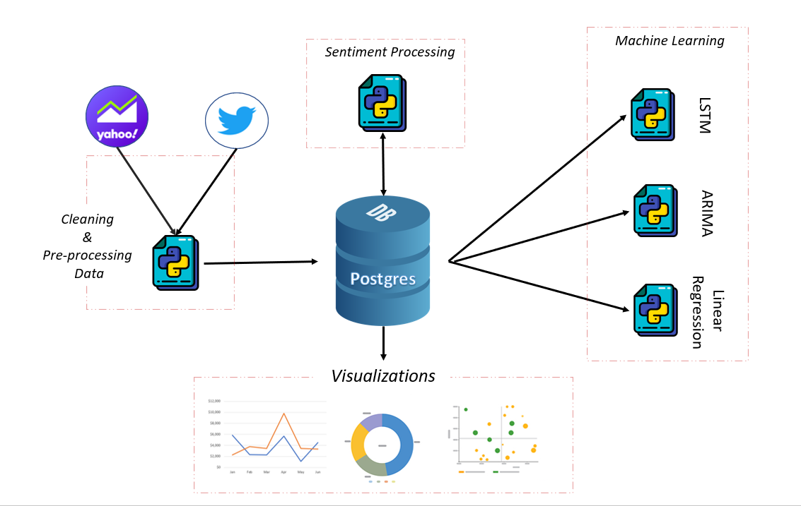
Proposed System

Slide 6
Approach
Retrieve
Retrieve tweet data and stock data.
Display
Display trends, predict stock and crypto price based on yahoo financial data.
Preprocess
Preprocess data dumps to clean. Store data in postgres database.
Run
Use sentiment analysis on tweets as positive, negative, or neutral.
Build
Use sentiment analysis inputs to build model for predicting impact of tweets on the near future stock price.

Slide 7
Data Exploration
Processed raw twitter and stock data
Structured data using jupyter notebook
Data Preprocessing (joined data)
EDA
Visuals/Insights

Slide 8
Training & Testing
Model | Training – Testing Criteria
Linear Regression | 80/20 Split Training – 80% Testing- 20%
ARIMA | Date Range Training (Jan 2010 – June 2021) Testing (July 2021 – July 2021)
LSTM | 80/20 Split Training – 80% Testing- 20%

Slide 9
Model Options
LSTM
Arima
Linear Regression
Long Short Term Memory
Autoregressive integrated moving average
Linear Regression
Special kind of recurrent neural network capable of handling long-term dependencies
80/20
Caters to a suite of standard structures in time series data, and as such provides a simple yet powerful method for making skillful time series
Developed in the field of statistics and is studied as a model for understanding the relationship between input and output numerical variables

Slide 10

Linear Regression on Financial combined with Tweets
Sum
Notes:
The idea is to see how long the effect of tweet lasts, and what is the percent increase in value.
Using percentages normalizes the data in that column.
Model built on building a percentage increase or decrease prediction. Includes the tweet likes, retweets, sentiment score. See the best way to do it to only include immediate reaction (very first stock price after) or if there is lingering reaction or delayed reaction in the following days.
Build a model on percentage increase than we can work on how to combine the predictions of two models.
7 day after creating a dictionary - have put tweet iD as a key.

Slide 11
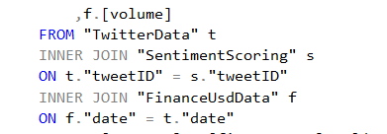
Database
Database created stores static scrapped data (finance and tweet data) for use during the project.
Database interfaces with the project by fetching data through queries and storing in database.
We are joining scrapped (Finance + Tweets) with sentiment data and pulling that for analysis and running the model on it. Joins can be found in stored procedures.

Slide 12
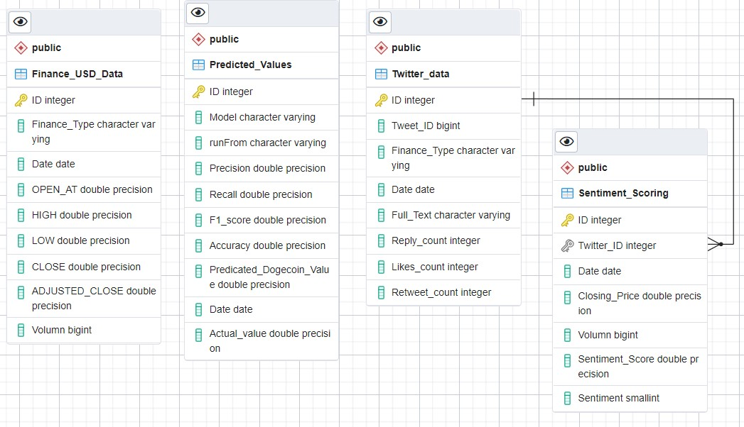
Entity Relationship Diagram
Twitter and Finance Data Joined
(for machine learning)

Slide 13
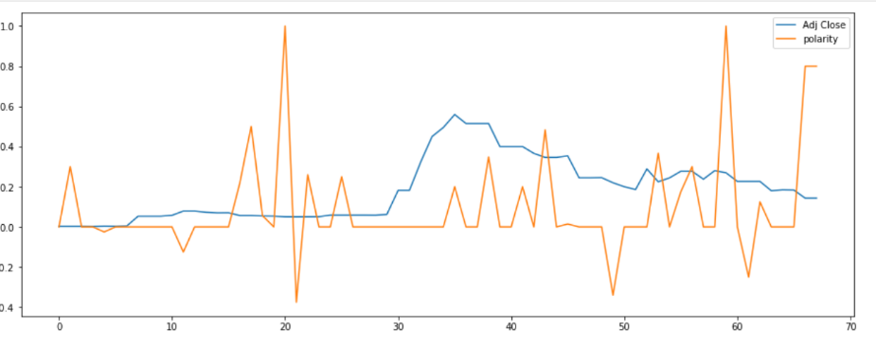
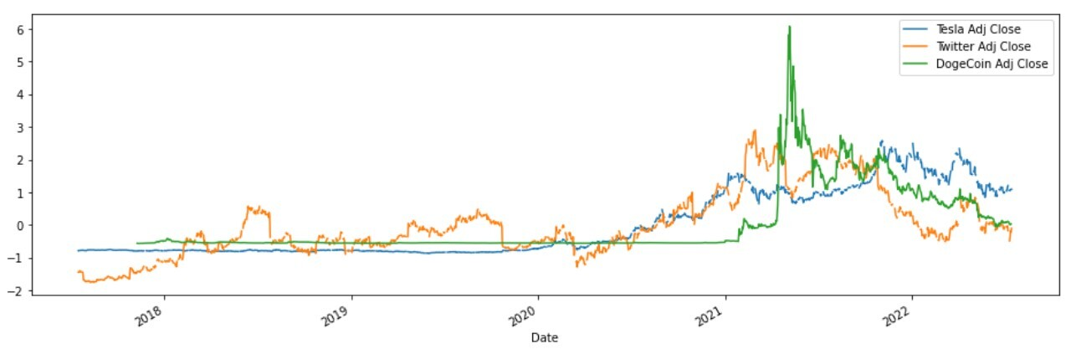
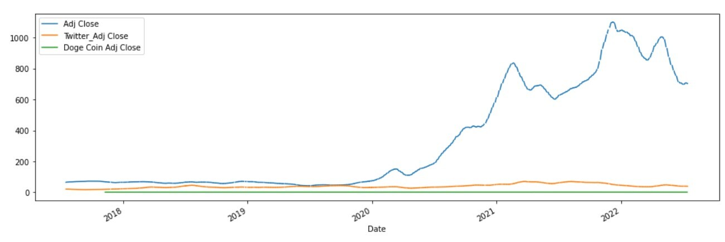
Visualizations
Adjusted Close with Sentiment Score
Marking the spikes and dips based on Sentiment Score impact
Scaled Adjusted Close for all

Slide 14
final Dashboard Tools
Visual
- Date variant tables and graphs through tableau
- Presented on a webpage created through java script.
PowerPoint
Interactive date selection

Slide 15
Limitations
EXPLANATION OF MODEL CHOICE
Benefits

Slide 16
Description of how they have trained the
model thus far, and any additional training
that will take place
Description of current accuracy score
Additionally, the model obviously addresses
the question or problem the team is solving.

Slide 17
TECHNOLOGIES
Machine Learning
Scikit learn
ApI’s
Tweepy
Yahoo Finance
Tableau
Twitter API
Tools
VSC
Tableau
Jupyter Notebook
Data Format
Csv
Json
Sql Tables
Languages
Python
Javascript
SQL
HTML
CSS
Database
SQL Server Express
(Queries, tables, stored procedures)
Libraries
Pandas
Numpy
Bootstrap 5.0, 5.2
Chartjs

Slide 18

Meet the team
Deepa
Shreha
Tamara
Vanessa
Data Analyst
Data Analyst
Data Analyst
Data Analyst

Slide 19
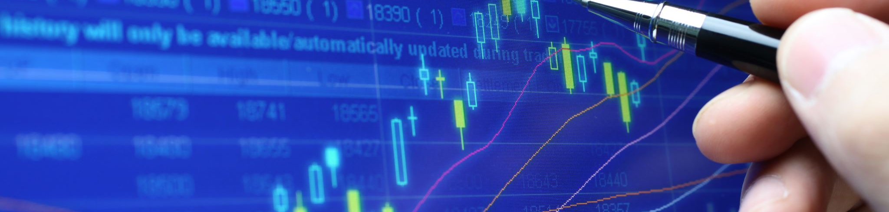
Summary
Problem statement: Impact of tweets on price
Predicting the price:
We are using LSTM or ARIMA for the financial data, so we will have two models for two scenarios.
Finding difference and applying with multiple regression.
Sum

